Slide 1
Kubernetes
11th October2018
Nilay Kumar Bose

Slide 2
Agenda
Micro Service Architecture
Key Concepts
Virtual Machines Vs Container
Kubernetes Architecture
Deployment in Kubernetes
Logging in Kubernetes
Continuous Integration and Delivery
Live Demo
Notes:
2

Slide 3
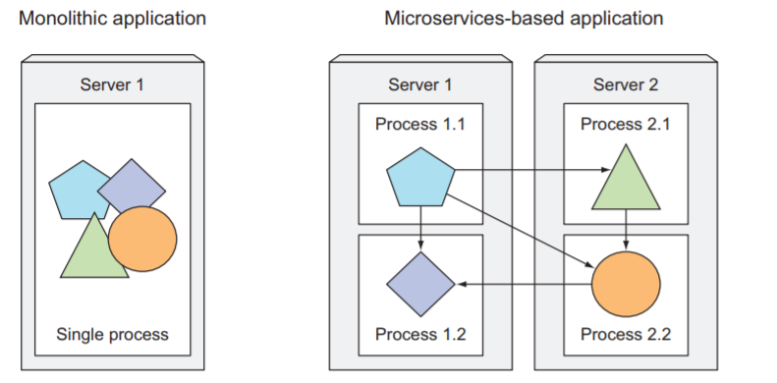
Micro-service Architecture
Breaking Monolith Application into Micro-service Architecture
Notes:
Monolithic applications consist of components that are all tightly coupled together and have to be developed, deployed, and managed as one entity, because they all run as a single OS process
3

Slide 4
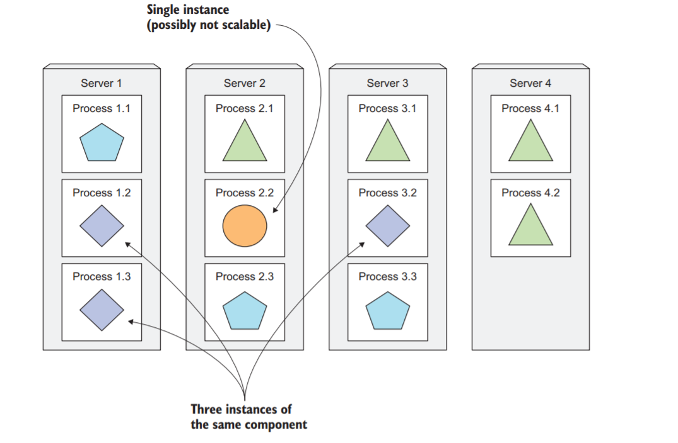
Micro-Service Deployment
Components are scaled independently
4

Slide 5
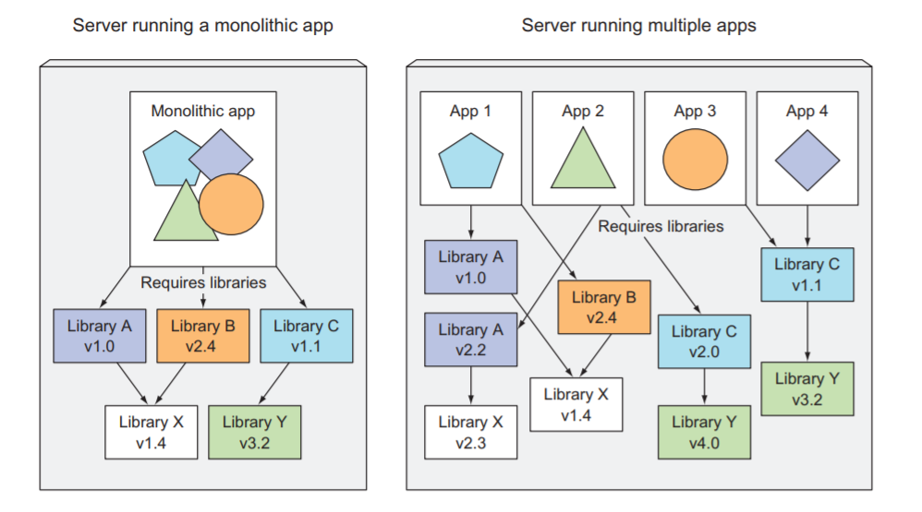
Challenges of Micro-Service Deployment
With number components increases, deployment-related decisions become difficult as deployment combinations and inter-dependencies between the components increases greatly.
Micro-services are hard to debug as they span multiple processes and machines.
5

Slide 6
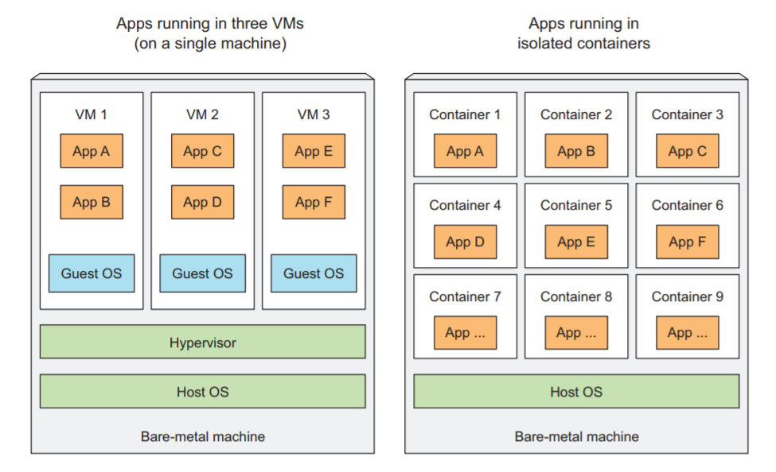
Application Isolation
Virtual Machines and Containers provide application Isolated Running Environments
6
Notes:
NOTE Two types of hypervisors exist. Type 1 hypervisors don’t use a host OS, while Type 2 do.
6

Slide 7
Understanding Docker Concepts
Images—A Docker-based container image is packaging our application. It contains the filesystem that will be available to the application and other metadata, such as the path to the executable that should be executed when the image is run.
Registries—A Docker Registry is a repository that stores our Docker images and facilitates easy sharing of those images between different people and computers.
Containers—A Docker-based container is a regular Linux container created from a Docker-based container image. A running container is a process running on the host running Docker, but it’s completely isolated from both the host and all other processes running on it. The process is also resource-constrained, meaning it can only access and use the amount of resources (CPU, RAM, and so on) that are allocated to it.
7

Slide 8
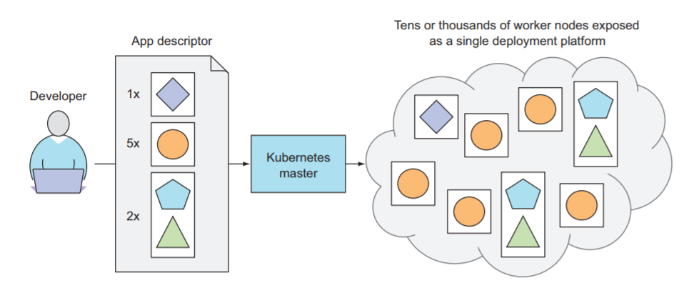
Understanding Kubernetes
Developed in Google and open sourced in 2014
Kubernetes is an open-source system for automating deployment, scaling, and management of containerized applications
Kubernetes exposes the whole data center as a single deployment platform. The system is composed of a master node and any number of worker nodes.
It abstracts away the underlying infrastructure and, by doing so, simplifies development, deployment, and management for both development and the operations teams.
8

Slide 9
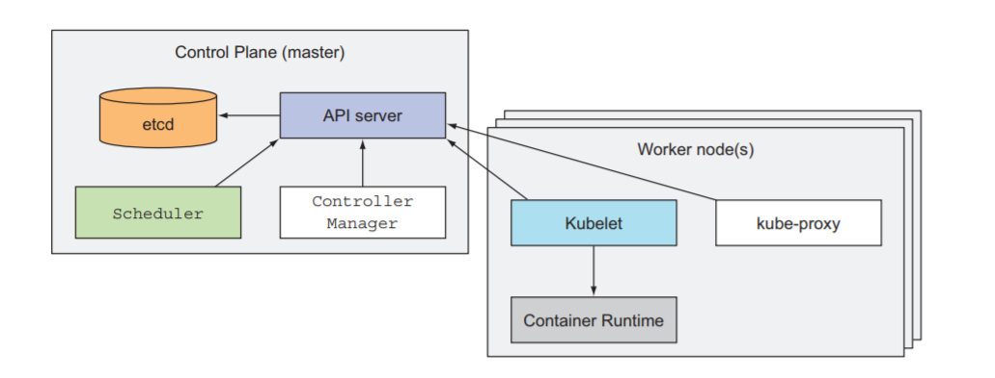
Kubernetes Internals
The Kubernetes API Server, which we and the other Control Plane components communicate
The Scheduler, which schedules your apps (assigns a worker node to each deployable component of your application)
The Controller Manager, which performs cluster-level functions, such as replicating components, keeping track of worker nodes, handling node failures, and so on
etcd, a reliable distributed data store that persistently stores the cluster configuration.
The Kubelet, which talks to the API server and manages containers on its node
The Kubernetes Service Proxy (kube-proxy), which load-balances network traffic between application components
9

Slide 10
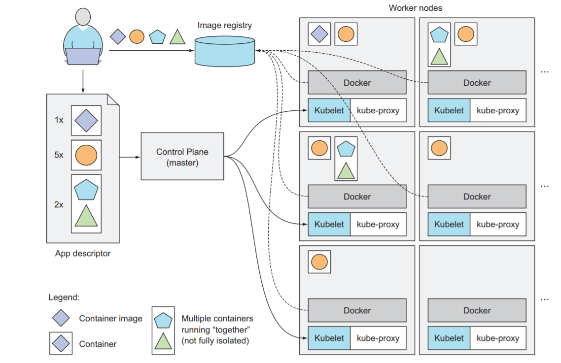
Understanding Kubernetes Internals Contd
10

Slide 11
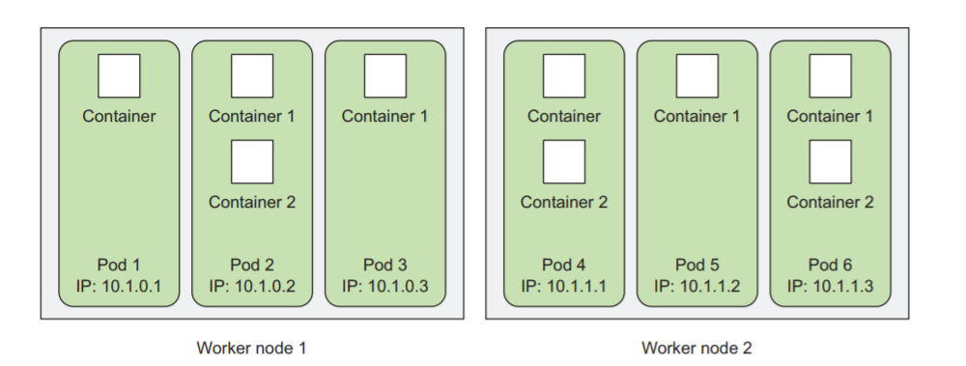
Kubernetes Objects
Pod – Group of containers
Each pod is like a separate logical machine with its own IP, hostname, processes
They’re ephemeral. A pod may disappear at any time on node failure
11

Slide 12
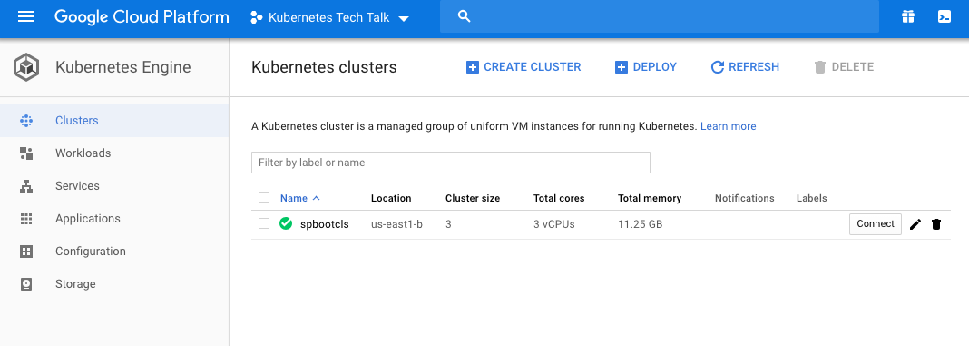
Kubernetes GKE – Cluster Creation
We will use Google Cloud Platform - Kubernetes Engine
We will need Google Cloud SDK and Kubectl (Client) to talk with the cloud cluster
Login to Cloud Platform and Create a Cluster with 3 Node
gcloud container clusters create spbootcls --num-nodes 3 --machine-type n1-standard-1
12

Slide 13

Kubernetes GKE – Cluster Creation (Validation)
Validate the nodes
Get the OS/ Other Information about the node
kubectl describe node gke-spbootcls-default-pool-3abca70c-tl48
SSH to the remote node
gcloud compute ssh gke-spbootcls-default-pool-3abca70c-tl48
13

Slide 14
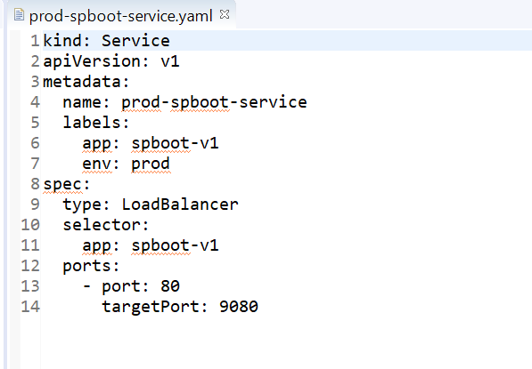
Kubernetes Objects - Service
External gateway to connect to the cluster
When a service is created, it gets a static IP, which never changes during the lifetime of the service
The service makes sure one of the pods receives the connection, regardless of where the pod is currently running
Here are a template for a service
Service Name
Load Balancer Type
Pick up pods with meta data app as ( spboot-v1)
Talk to pod at port 9080

Slide 15
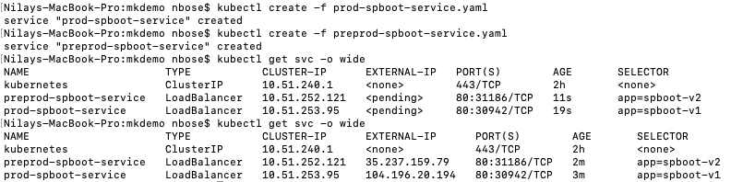
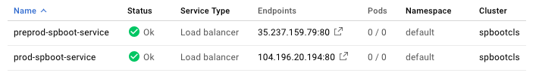
Kubernetes Objects – Service Continued
Create the Service prod-spboot-service.yaml & preprod-spboot-service.yaml
GKE Services

Slide 16
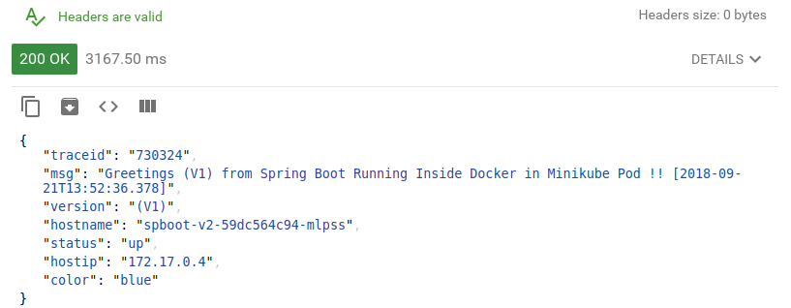
Kubernetes Deploying First Application
Spring Boot Application with the following response
16

Slide 17
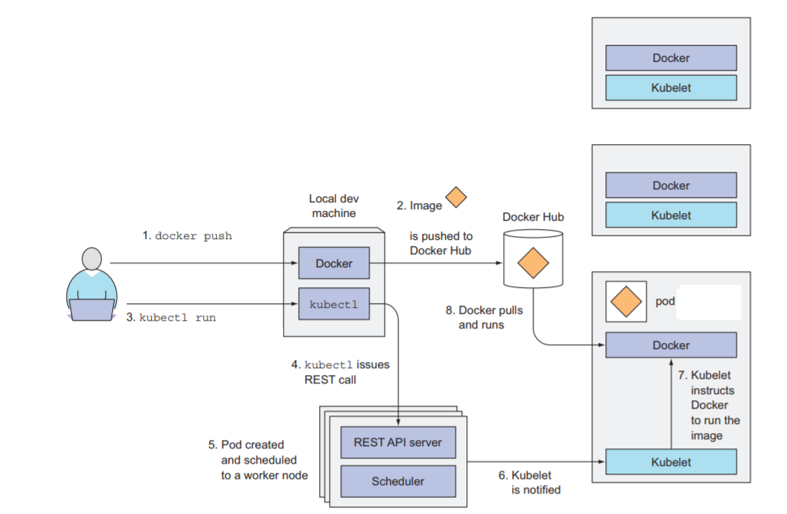
Kubernetes Deploying First Application

Slide 18
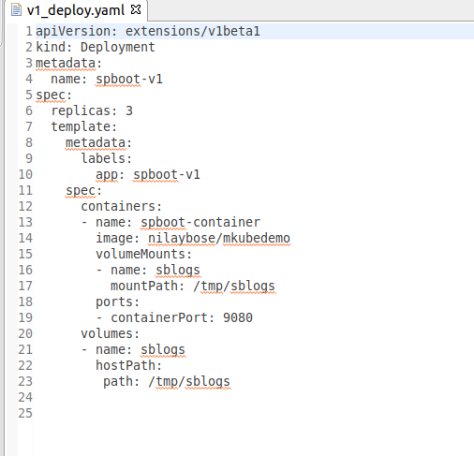
Kubernetes Deploying First Application Contd
Example of Deployment Descriptor to Install an application
Replicas as pods
Pod meta data to be picked up by service
Docker Image
Volume mounted in Host
18

Slide 19
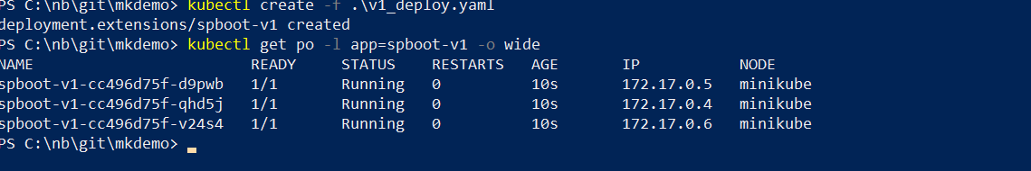
Kubernetes Deploying First Application Contd
Validate the PODS and the Internal Cluster IP
19

Slide 20
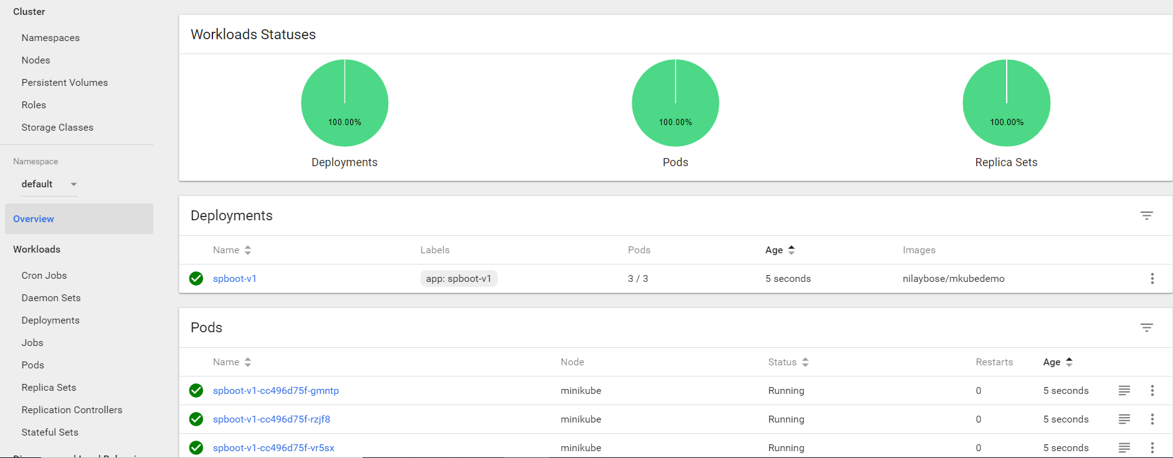
Kubernetes Deploying First Application Contd
Dashboard Reflecting status of Pods
20

Slide 21
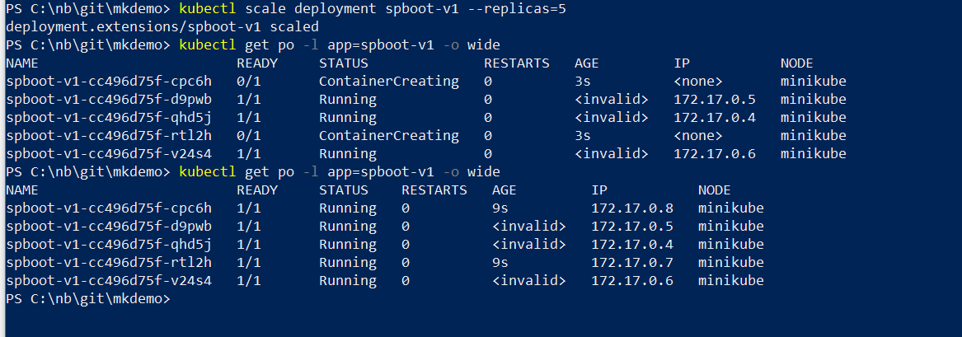
Kubernetes Scaling up Deployment
Increase Replica from 3 to 5
Creating new pods
21

Slide 22
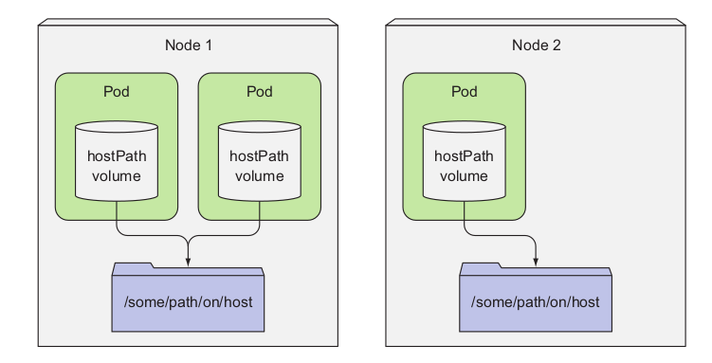
Kubernetes Volumes
Kubernetes volumes are a component of a pod and are thus defined in the pod’s specification—much like containers.
A volume is available to all containers in the pod, but it must be mounted in each container that needs to access it.
A hostPath volume points to a specific file or directory on the node’s file system
Pods running on the same node and using the same path in their host - Path volume see the same files
22

Slide 23
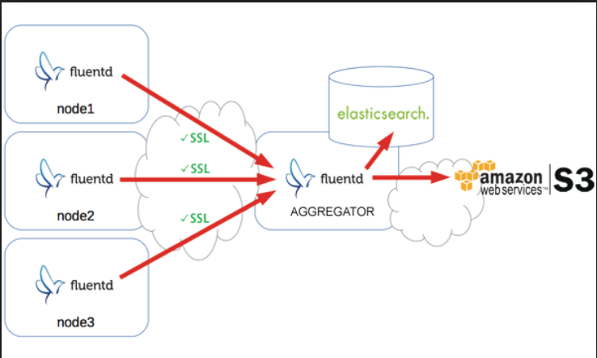
Kubernetes Logging
Application and systems logs can help you understand what is happening inside your cluster
The native functionality provided by a container engine or run time is usually not enough for a complete logging solution
If a container crashes, a pod is evicted, or a node dies, We still want to access your application’s logs.
As such, logs should have a separate storage and life cycle independent of nodes, pods, or containers
Kubernetes provides no native storage solution for log data, but we can integrate many existing logging solutions into your Kubernetes cluster.
23

Slide 24
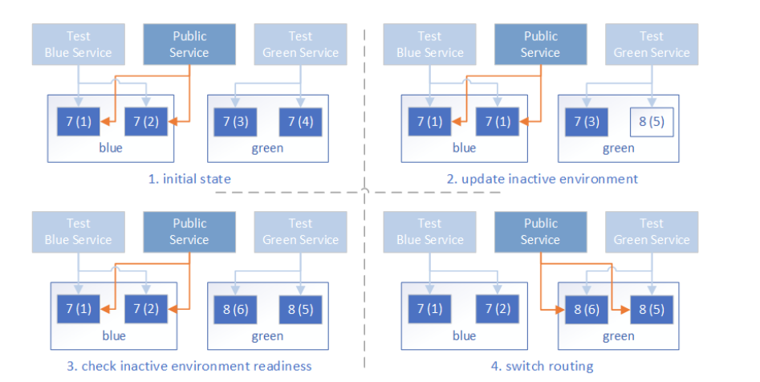
Kubernetes Blue/ Green Deployment
A blue/green deployment is a change management strategy for releasing software code. Blue/green deployments require two identical hardware environments that are configured exactly the same way. While one environment is active and serving end users, the other environment remains idle
Container technology offers a stand-alone environment to run the desired service, which makes it super easy to create identical environments as required in the blue/green deployment
24

Slide 25
Kubernetes Advanced Topics
Auto scaling
Persistent Volumes
Stateful Replica Sets
Secrets
25

Slide 26
Commercial Kubernetes
Open Shift ( Red Hat ) – Used in Heritage World Pay
EKS (Amazon Elastic Container Service for Kubernetes)
GKE (Google Kubernetes Engine)
AKS - Azure Kubernetes Service
26

Slide 27
Reference & Links
https://kubernetes.io/
https://kubernetes.io/blog/2018/04/30/zero-downtime-deployment-kubernetes-jenkins/
GIT Hub Code base
https://github.com/nilaybose/mkdemo
Docker Image Path
docker pull nilaybose/mkubedemo
27

Slide 28
Thank You
28

